Slide 1
Storage Connector
Alexandro Bolfa

Slide 2
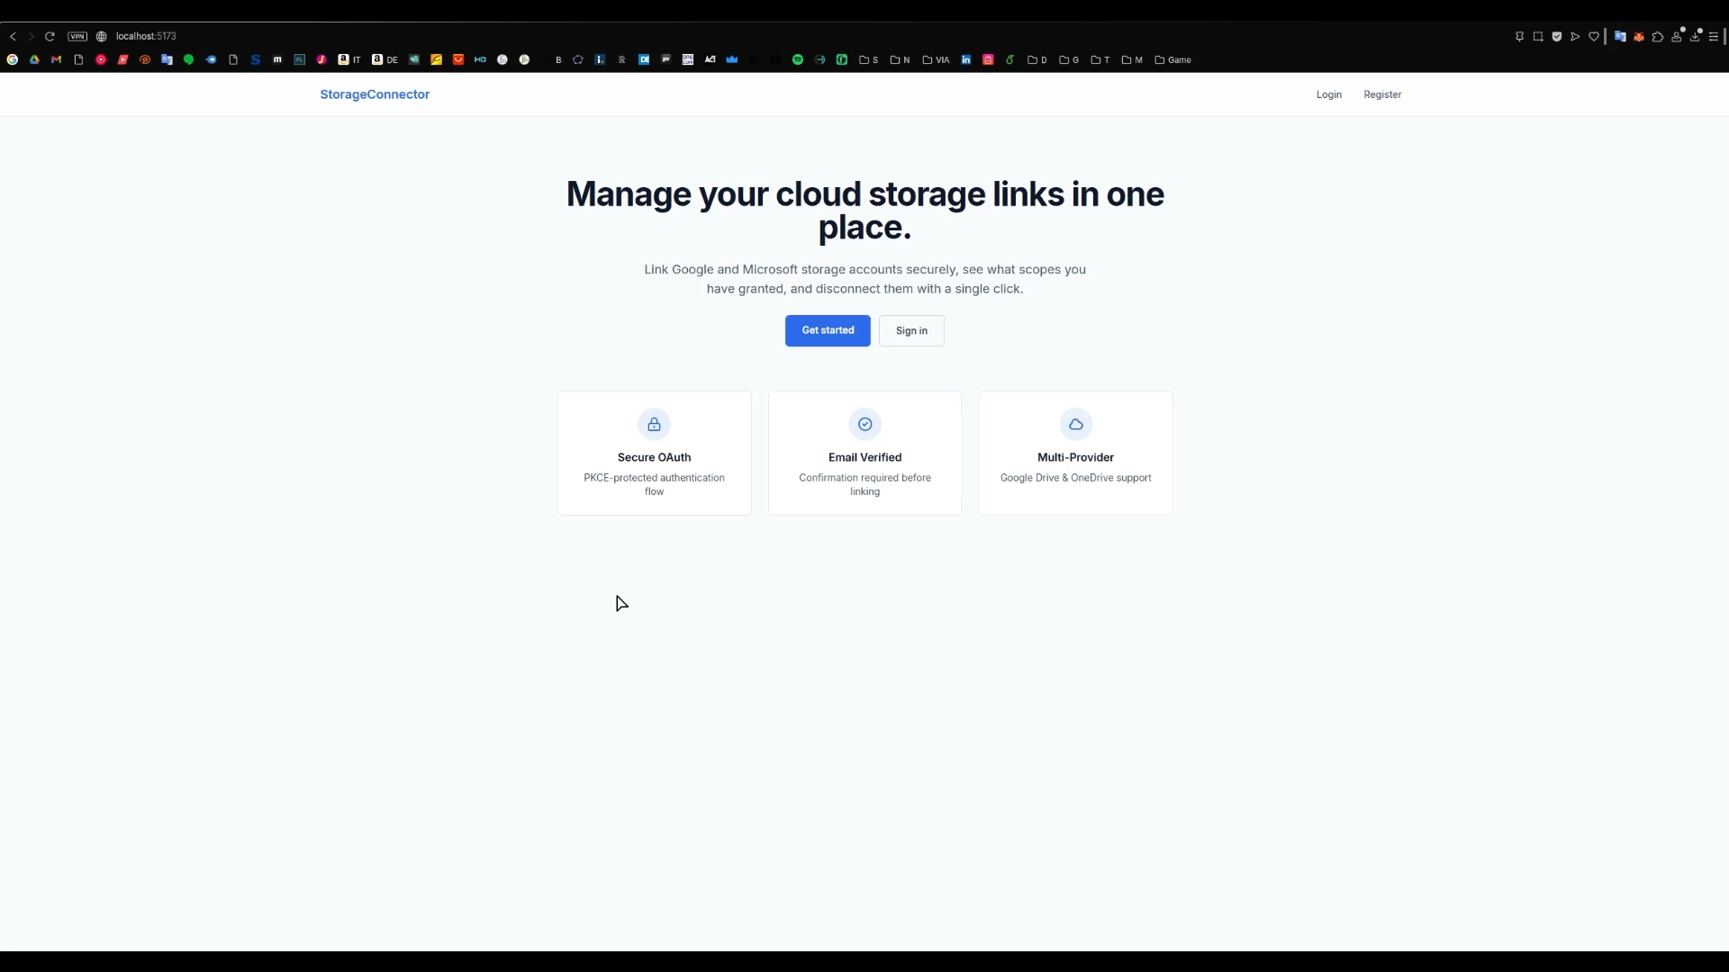

Slide 3
Overview

